Slide 1
Data Structures in Java

Slide 2
Key Topics
Data Structures Introduction
The Java Collection Framework
Iterating Over a Collection
Maps
Comparing Objects

Slide 3
Data Structures Introduction

Slide 4
What is a Data Structure?
A data structure is a format for storing and managing more than one piece of data
Arrays are data structures
Elements can be removed, added, searched for, etc
Each data structure has its own way of storing and working with the data it holds
There are two fundamental ways of storing information in data structures:
In arrays
With nodes

Slide 5
Array Based Structures
array-based structures simply use an array to store the data
Because arrays are used, data is saved in positions that each have corresponding indices.
Array-based structures further build on an array by modifying how the values are accessed and worked with
An arraylist is an array-based structure. It uses an array to store the data but defines a specific way of managing and accessing the data
Info
Index: 0
Info
Index: 1
Info
Index: 2
Info
Index: 3
Info
Index: 4
Info
Index: 5

Slide 6
Node Based Structures
A node-based structure stores information in node objects which may have one or more references to other node objects.
Recall that reference variables point to an object’s location in memory
Node objects usually contain data as well as reference variables that point to the previous and/or next node in the structure
data variable
ref variable
data variable
ref variable

Slide 7
Simple Node Class
public class Node {
// Data
private Integer data = 0;
// Reference to next node
private Node next = null;
// Constructors
public Node(Integer data) {
this.data = data;
}
public Integer getData() { return data; }
public void setData(Integer data) { this.data = data; }
public Node getNext() { return next; }
public void setNext(Node next) { this.next = next; }
@Override
public String toString() {
return "Node: data ="+this.data;
}
}
We could structure this Node differently if we wanted to support a different data structure.

Slide 8
Stack
Many data structures can be supported differently with either nodes or arrays behind the scenes – for example:
public class ArrayStack {
int[] stack = new int[5];
int lastElementIndex = 0;
public void push(int element) {
if(lastElementIndex >= stack.length) {
int[] newStack = new int[stack.length*2];
for(int j = 0; j<stack.length; j++) {
newStack[j] = stack[j];
}
stack = newStack;
}
stack[lastElementIndex] = element;
lastElementIndex++;
}
public Integer pop() {
if (lastElementIndex> 0)
return stack[--lastElementIndex];
else
return null;
}
public int peek() {
return stack[lastElementIndex-1];
}
}
public class NodeStack {
Node top;
public void push(int element) {
Node node = new Node(element);
push(node);
}
public void push(Node node) {
node.setNext(top);
top = node;
}
public Node pop() {
Node poppedNode = top;
top = top.getNext();
poppedNode.setNext(null);
return poppedNode;
}
public Node peek() {
return top;
}
}

Slide 9
Java Collection Framework

Slide 10
The Collection Interface
The Java Collection Framework provides built-in data structures for the user to work with
It contains interfaces that define what behavior the data structures should have
It also contains concrete classes that represent each data structure
The main branch of the Collection Framework is the collection hierarchy. Its root is the Collection interface and it defines a set of behaviors common to all collections in Java (except Maps, which are in another branch entirely)
https://docs.oracle.com/javase/8/docs/api/java/util/Collection.html
Collections can be broken down into three types: Lists, Sets, and Queues

Slide 11
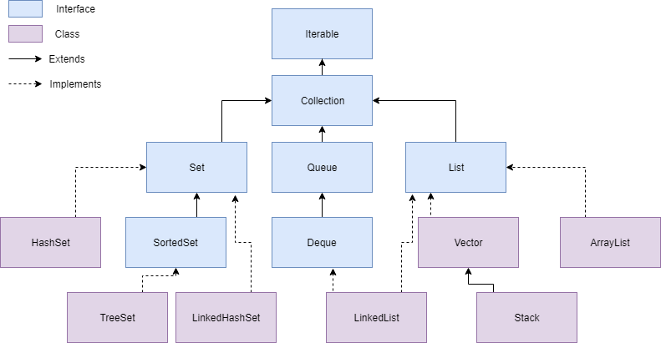
Collection Hierarchy

Slide 12
Important Interfaces in the Collection Framework
Iterable – Requires that every collection can be iterated over (each element can be accessed, one by one)
Collection – An Interface in Java that defines an architecture for storing and manipulating objects
Set – A collection which cannot contain duplicate elements
Queue – An ordered collection of objects which utilizes a first-in-first-out principle
List – An ordered collection of objects which utilizes indexes

Slide 13
Iterating Over a Collection

Slide 14
Iterating Over a Collection
Recall that the Iterator interface requires that each collection implement traversal, or the behavior of blindly moving through each element in a collection
Each collection’s structure can be different from one another
This makes having a universal way of traversing difficult
The collection itself provides the implementation for how to traverse that specific type of data structure
Every collection has an iterator() method that returns an Iterator object capable of unidirectional “blind” navigation
Unidirectional: Can only move to the “next” element
Blind: no sorting is guaranteed, no telling what the “next” element is going to be

Slide 15
Enhanced For-Loop
We can use an enhanced for-loop with collections, just like we can with arrays
For collections, the enhanced for-loop uses an iterator “behind the scenes” to iterate over it
public static void main(String[] args){
// create a collection
HashSet<String> someSet = new HashSet<>();
// add values into the collection (omitted)
// #1. Iterate using iterator
Iterator iter = someSet.iterator();
while (iter.hasNext()) {
System.out.println(iter.next());
}
// #2. Iterate using for-each loop
for(String s : stringSet)
System.out.println(s);
}
}

Slide 16
Collection vs Collections
Collection is an interface that declares mandatory behavior for collections
Collections is a utility class filled with static methods that can be run with Collection subclasses.
The Arrays class is also a utility class that is useful for working with arrays.
https://docs.oracle.com/javase/8/docs/api/java/util/Collections.html

Slide 17
Maps

Slide 18
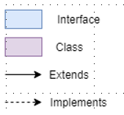
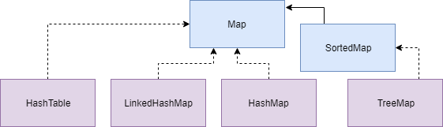
Map Hierarchy
Although maps are a branch of the Collection Framework, they are not collections
Collections are groups of objects
Maps are groups of key-value pairs

Slide 19
Creating Java Maps
When you create a collection, you specify the type of objects it will hold. This is due to the use of Generics in Collections. More on this soon!
When you create a map, you must specify the type of key and the type of value that it will hold
List<String> list = new ArrayList<> ();
Map<String, Integer> map = new HashMap<> ();

Slide 20
Map vs Collection Methods
 | Collection | Map
Add an element | add(object) | put(key, value)
Remove an element | remove(object) | remove(key)
Iterate over data structure | For-each loop | get something iterable using either keySet(), values(), or entrySet() then use for-each loop

Slide 21
Generics
Generics in Java allows us to use placeholder types that can be used as parameters for either classes, interfaces, or methods
Generics allow us to reuse a class, interface, or method with different input types
The generic type will be replaced with the actual type specified when using the class, interface, or method
Maps and collections use generics so that with just one concrete class, you can create data structures that each can store a different type of data

Slide 22
Generics
// 'T' is a placeholder for a datatype
public class Example<T> {
private T data;
// parameterized Constructor referencing 'T'
public Example(T data) {
this.data = data;
}
// Getter and Setter referencing 'T'
public T getData() {
return data;
}
public void setData(T data) {
this.data = data;
}
}
public class Simulator {
public static void main(String[] args) {
Example<String> ex_str = new Example<String>("Revature");
Example<Integer> ex_int = new Example<Integer>(55);
}
}

Slide 23
Comparing Custom Objects

Slide 24
Comparing Collection Elements
When you need to sort a collection, you need to compare two elements at a time to evaluate which comes before or after the other.
Java has two interfaces you can use to make your custom objects comparable: Comparable and Comparator

Slide 25
Which interface to use?
public interface Comparable<T> { int compareTo(T other); }
public interface Comparator<T> { int compare(T objectA, T objectB); }
 | Comparable | Comparator
When to use? | To provide a default sorting order | To provide an alternative sorting order
Which class implements it? | The class of the objects being compared | A third-party class
What method does it define? | compareTo which takes in one object | Compare which takes in two objects

Slide 26
Writing the Comparison Logic
compare() and compareTo() both compare two objects and return an integer
If you want the objects sorted in ascending order, your logic should follow these rules:
If object A comes before object B, the result should be less than 0
If object A has the same place as object B, the result should be 0
If object A comes after object B, the result should be greater than 0.
Reverse the logic to sort in descending order

Slide 27
Recall
What is a data structure?
What is the Java Collection Framework?
What is a Set, Queue, List, and Map?
How are collections iterated over?
What are some methods I can use with collections? With Maps?
What are generics and why should I use them?
How do I create a sorting order for a custom object?

